Slide 1

R-ticulating Data
A Data Cleaning and Visualization Demo
Jeremy R. Groves, Ph.D, ACUE
Tech Tacos – November 18, 2025

Slide 2
Setup
Do you have R and R-Studio Installed?
  Create a new project
  If you have/use GIT, you can clone the repo in project setup, if not, we will get it in a second.
  https://github.com/jrgroves/Rticulate
If no R, use the POSIT cloud where students can log into free and create a project so that they can use the R-Studio interface.
Go To: https://posit.cloud/
Create an account (using any email)
Choose a New R Studio Project from the upper left corner.

Slide 3
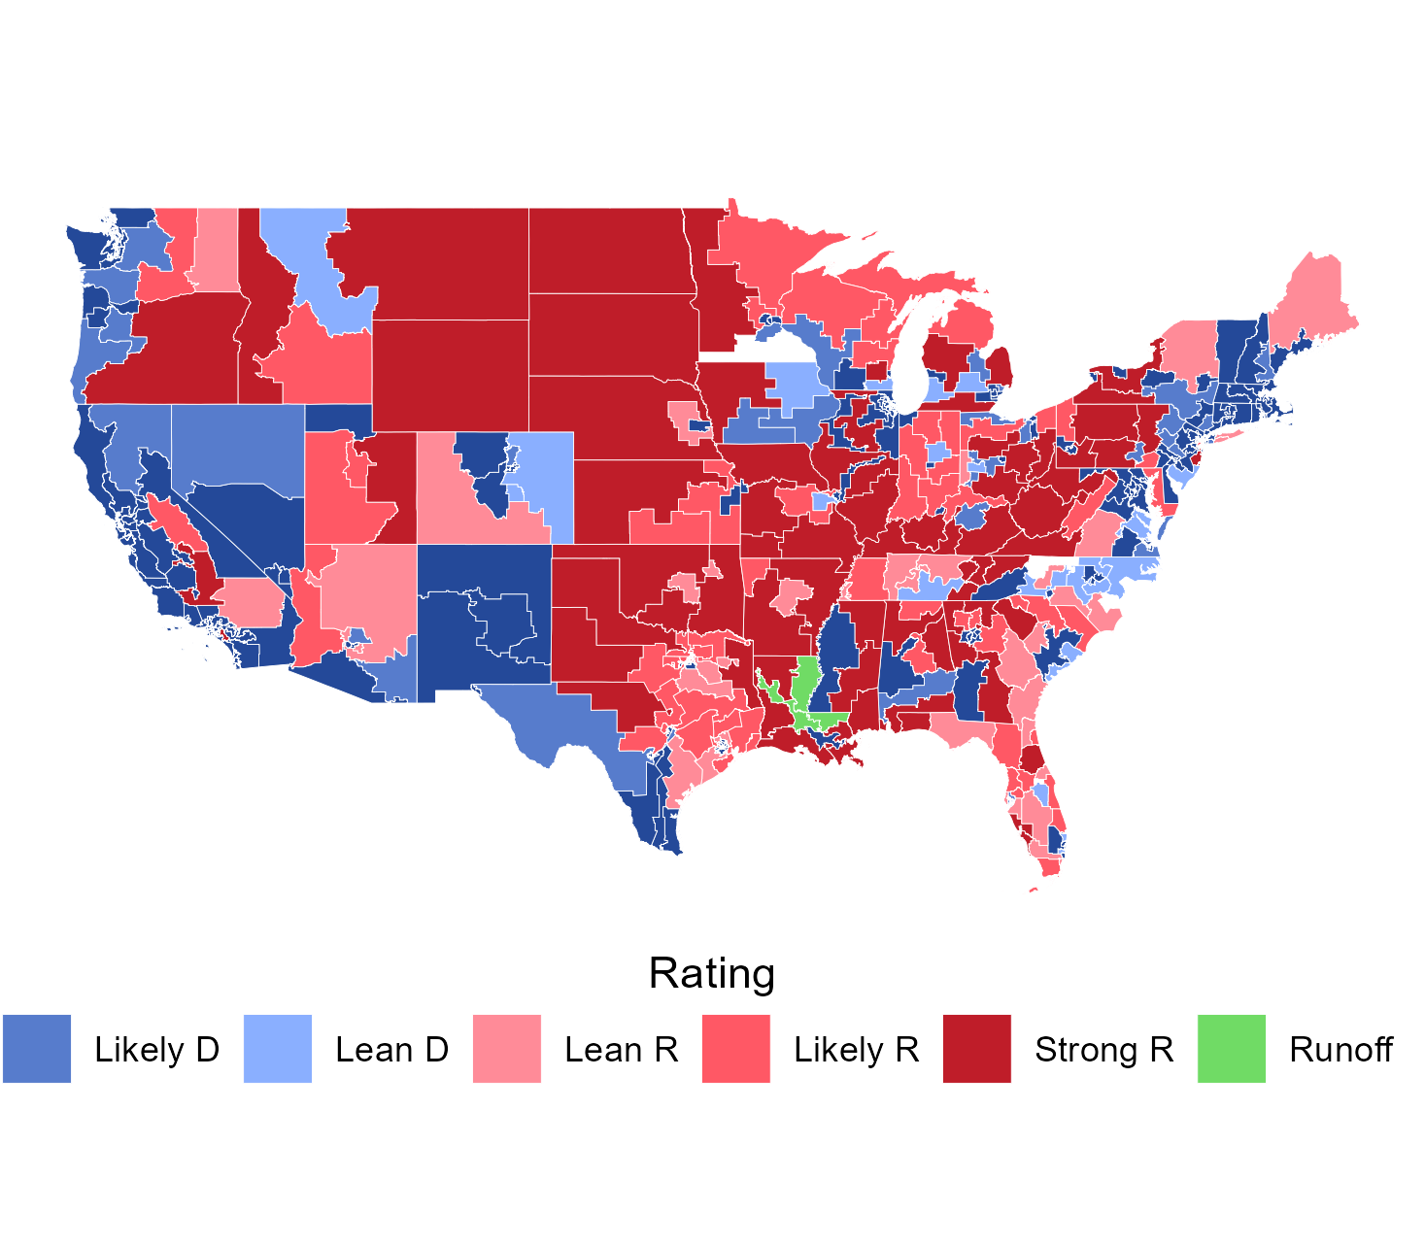
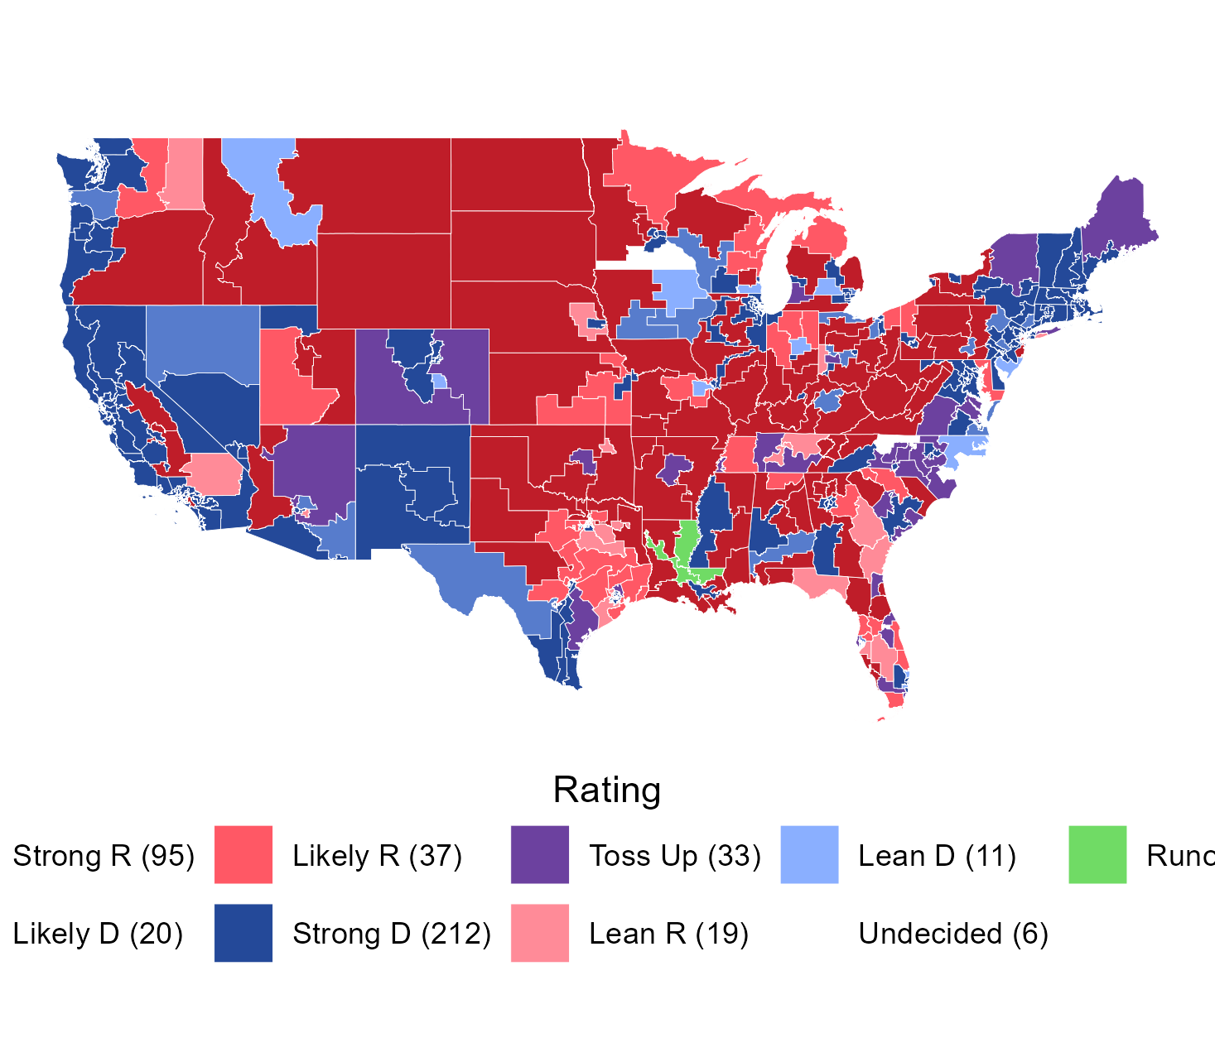

Slide 4
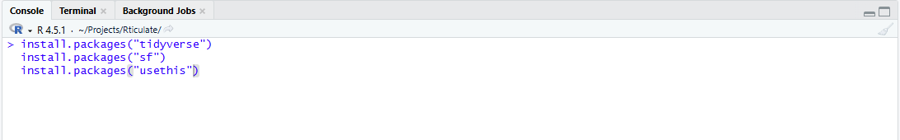
Setup
Type the code below in the console to ensure you have the needed packages installed. Make sure press ENTER after each line.
This will install the necessary packages for our work.
  tidyverse is a great package for cleaning data and writing scripts
  sf is a package for all our GIS and mapping needs
  usethis is a package we can use for getting our data without GIT.

Slide 5

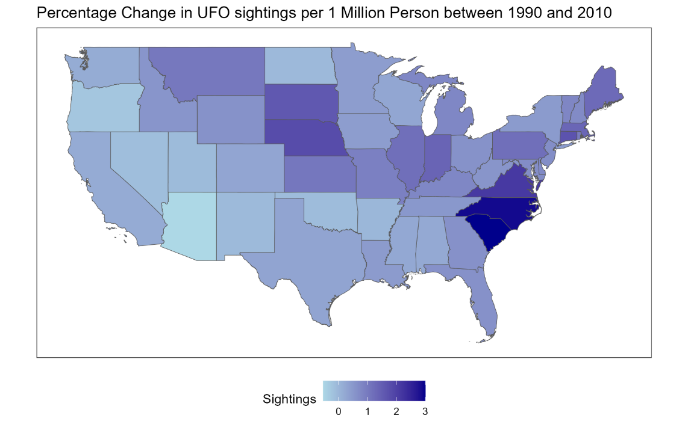
Our Mission
Visualize the percentage change in the number of UFO sightings per person in the continental U.S. between 2000 and 2010.

Slide 6

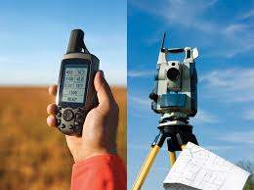
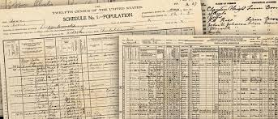
A quick detour
Getting the data you need can be the most complicated part of a project. There are several ways to accomplish this task
Original Collection. This may be going out and measuring something or collecting information or may simply be the transfer of archival data from print to digital formats.

Slide 7
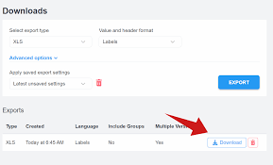
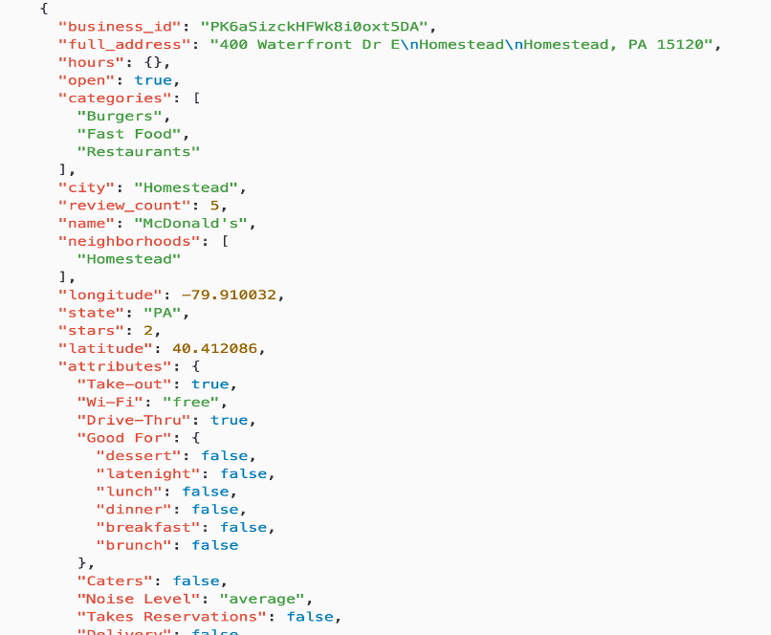
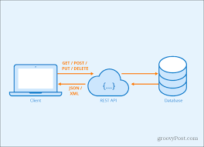
A quick detour
Downloads: This can include data from a primary source such as Redfin or Zillow for housing data, from an API source such as a government or industry database/website, or from cloud storage such as OneDrive or GitHub.

Slide 8
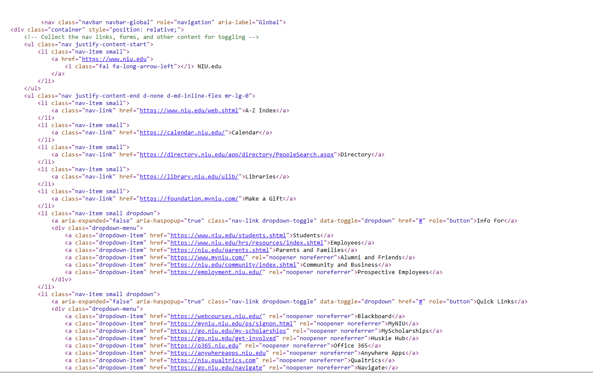

A quick detour
Scrape It: Web-scaping is the process of exploiting the fact that websites, as pretty as they might be, are still just a code written on a system according to a language.

Slide 9
Our Data
We get our data from three primary sources. For time saving, it is already going to be in the reop or zip file you download.
UFO Sightings: National UFO Reporting Center (https://nuforc.org/) and Kraggle (https://www.kaggle.com/datasets/NUFORC/ufo-sightings)
USA Map: U.S. Census Bureau (https://census.gov) Tiger Line Files (via Census API)
Population Data: IPUMS NHGIS (via IMPUS API) (https://www.ipums.org/projects/ipums-nhgis)

Slide 10
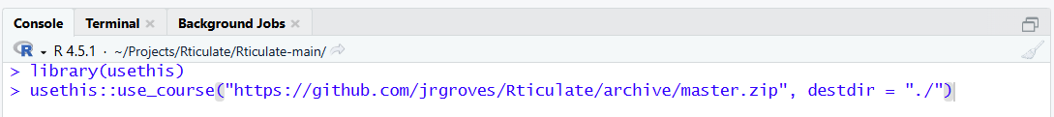
Getting Our Data
Option 1: Clone the GIT Repository
  If you created your project using version control, the data was cloned in with the setup.
Option 2: Use the use_course() command to download
  This will allow you to download the makeup of the GIT REPO and it will install into whatever your current directory is.
  This will likely open a new session of RS, but that is fine.

Slide 11
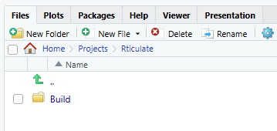
Finding our Data
File Manager in RStudio (RS)
  In the lower-right pane in RS, you will find a FILES tab. This will show you the files and folders in your current working directory.
  We have set up our file structure all under the “Build” folder
Build
Code
Input
Build
Code
Input
Analysis
Code
Input
Output
Output
Good structure for readability

Slide 12
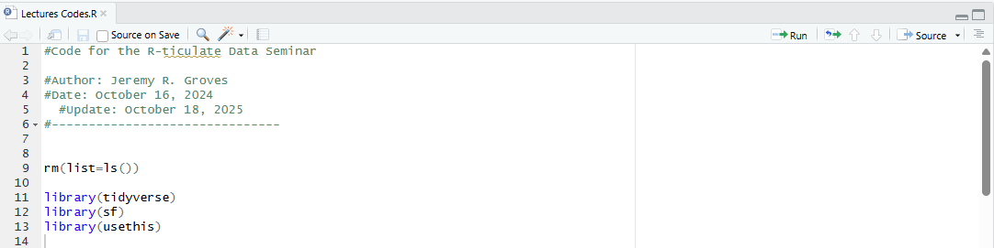
Scripting
With any project it is important to keep track of what you are doing and design it in such as way as to make it reproducible.
Open a new script using the in the upper-left corner of RStudio.
Start by adding a title and description, clean our workspace, and load our libraries.

Slide 13
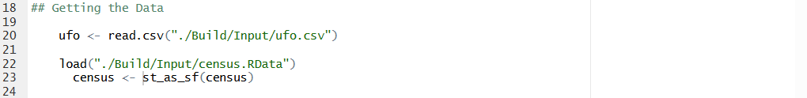
Loading in our data
Once we have our libraries loaded, we need to put the data we will use in our Environment.
This will read the text file of UFO sightings and two pre-made Rdata files that we created using the APIs {the code is in the Build Data.R script}.
Note that this code assigns each dataframe to the object that is located at the start of the line {R is an objected orientated language, so everything is an object of some type}

Slide 14
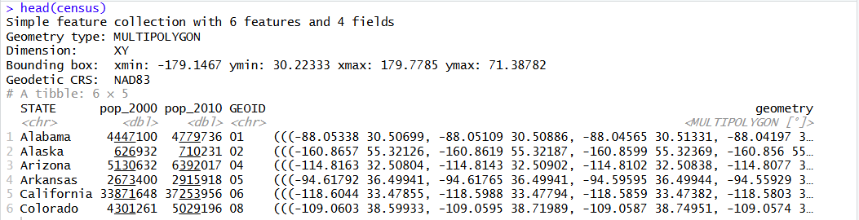
Viewing the Mess
We can use the head() command to see what our data looks like. You can type the command directly in the console if you like.
This is an ‘sf’ object meaning that is designed for geographic work {see the projection information} and the ‘geometry’ column which contains the coordinates for the shapes {state outlines}.

Slide 15
Viewing the Mess
Quickly note that we can view the head of a specific column using the df$colname syntax in the head() command.
This is where the package tidyverse shines because we can easily remove, manipulate, filter, and reorder our dataframe all in a single command.
To do this we use the ‘pipped’ code to “nest” commands.[ %>% ]

Slide 16
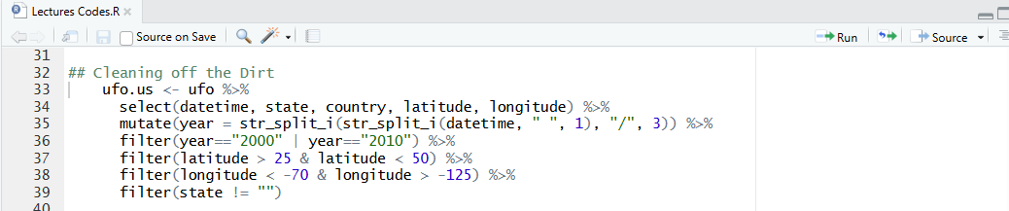
Scripting our cleanup
We do quite a bit here and will discuss each line
  Assign our new data to a new object (ufo.us) and then setting what dataframe we start with (ufo).
  We limit our dataframe to only the columns (vectors) we need
  We create a new vector called “year” and then split up the character string that is currently our datetime vector to extract the year.
str_split_i(column name, what we split on, part we want to keep)

Slide 17
Scripting our cleanup
  Keep only sightings that occurred in 2000 and 2010 using the filter command {and logic operator | which is “or”}.
  Remove anything outside the longitude which we can attribute to the US {this is one of those things you find by trial and error}
  Same as above just with longitude.
  Remove any item that is missing the state ID.

Slide 18
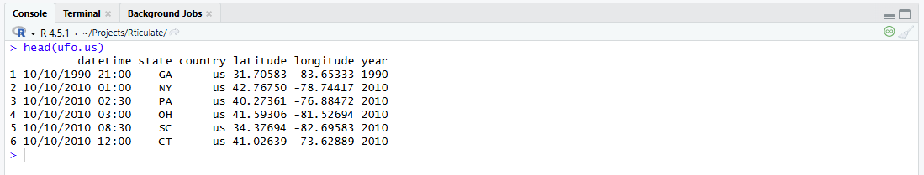
Check In
To see what we have and to make sure we are progressing, we will look at the head of our new object.
We see that we have a single observation for each sighting, the abbreviation for the state it occurred and the year it occurred along with some other things we no longer need.
This type of data is called LONG DATA but we want WIDE DATA.

Slide 19
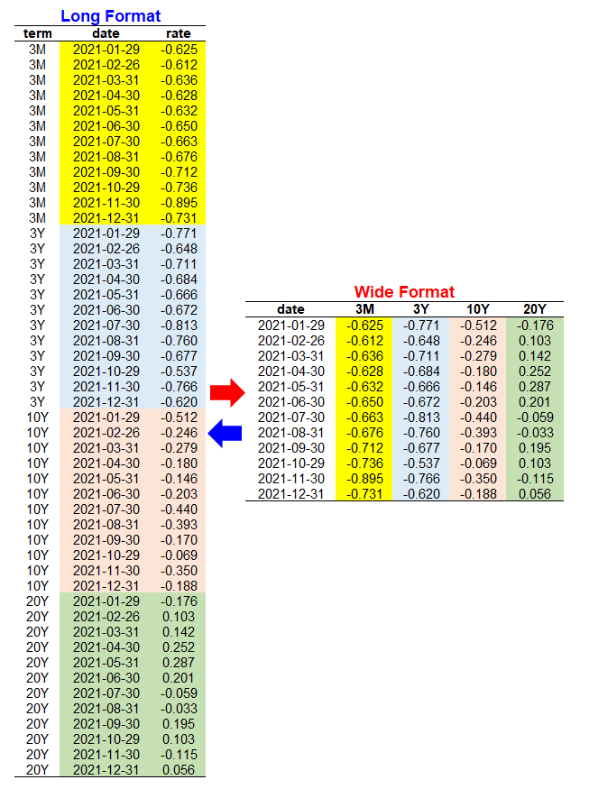
Long and Wide
Think of moving from long to wide as an aggregation.
In our case, we want to aggregate the number of sightings by state and by year.
There are several ways we can do this, but we are going to use the set of pivot commands in tidyverse.
  id_cols: This is the name of the vector(s) that is our key identifier.
  names_from: What each new vector is going to be named (the grouping)
  names_prefix: R does not allow vector names to start with a number.
  values_from: What vector are we going to aggregate
  value_fn: How do we aggregate that vector?
pivot_wider(id_cols, names_from,
names_prefix, values_from, values_fn)

Slide 20
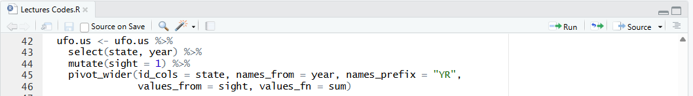
Scripting our Cleanup
We update by our existing dataframe by simply assigning it to the same object name as we did before {warning: make sure you want to do this}
  Assign our object name and give our starting dataframe
  Keep only the two variables we need
  Create a new vector to give the pivot_wider() command something to count.
  Use the pivot_wider() command to group by states and create a count for each year (with the prefix in the column name) and add up (sum) the values from the sight column.

Slide 21
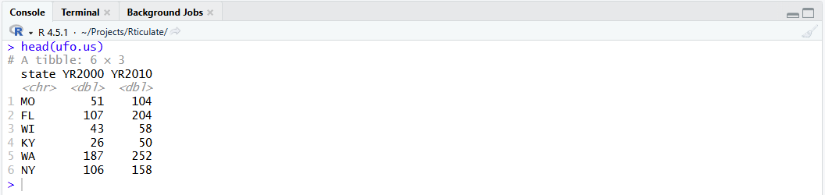
Scripting our Cleanup
Use our head command to look at how our data changed
Rather than having a row for each sighting, we have a row for each state with a column showing the total number of sightings in each state for each year.

Slide 22
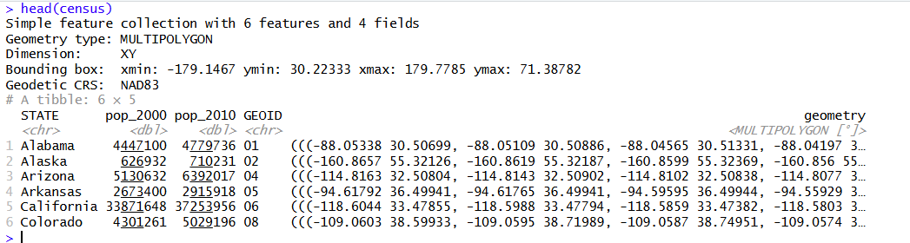
Adding our Potential Abductees
If we compare our ufo and census data, we will notice we have a bit of an issue.
The census data is listed by state name or GEOID while our UFO data is listed by state abbreviation. There are a few ways to deal with this:
  We can create a text file to “bridge” the two dataframes.
  We can create a new column with either abbreviations or GEOIDs in the UFO data.

Slide 23
Load and Merge / Join
When we have several different datasets, we can merge or join them based on common elements. In tidyverse there are three main ways to join data.
  left_join(df1, df2): this will join two datasets keeping all matched pairs and any unmatched objects from the FIRST dataframe.
  right_join(df1, df2): this will join two datasets keeping all matched pairs and any unmatched objects from the SECOND dataframe.
  full_join(df1, df2): this will join two datasets keeping all matched pairs and any unmatched objects from BOTH dataframes.
Another advantage of the commands in tidyverse we can join two dataframes even if the column names are different.

Slide 24
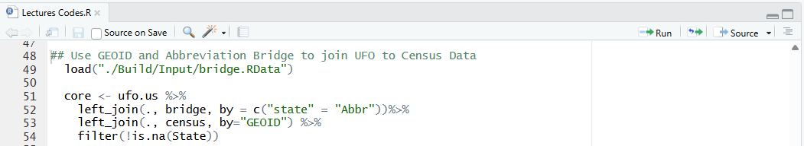
Load and Merge / Join
  Loads the bridge file we previously created.
  Create our new dataframe
  Join with the bridge file keeping all elements in the ufo.us dataframe and discarding any unmatched from the bridge file. Joining by the state and Abbr vectors.
  Join with the census file keeping all elements of our newly joined file from 74 and discarding any unmatched from the census file. Join on the common element GEOID.
  Filter out any cases where State (which is from census file) has missing data.

Slide 25
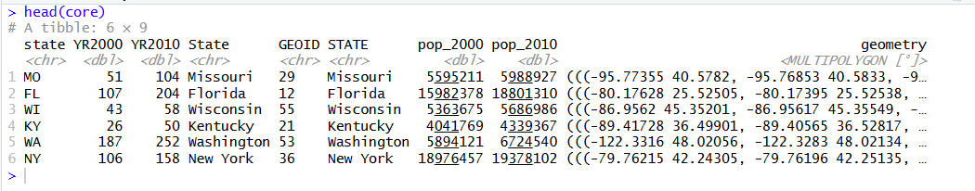
Load and Merge / Join

Slide 26
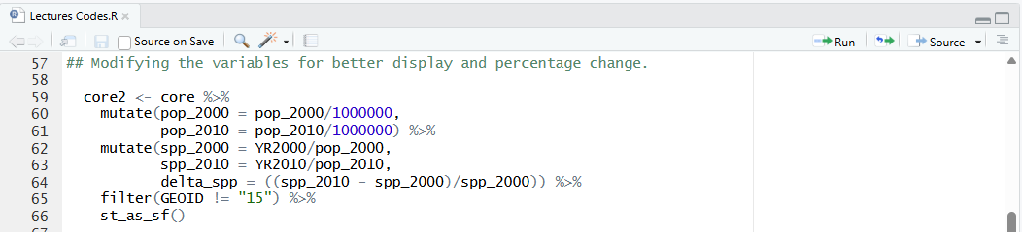
Creating what we want to show
Now that we have brought together data that likely never thought they would ever meet, we want to massage it into something we can display.
  Scale our population measures to ‘per one million persons’ so we can show numbers that make a bit of sense.
  Divide sightings by the adjusted population
  Calculate the percentage change between 2000 and 2010.
  Get rid of Alaska
  Reset our new object as an ‘sf’ object so we can plot it.

Slide 27
Visualization of Data
Whether you are a full professor or still a student, one of the key elements of our job is to be able to convey ideas to fellow professionals (both within and outside economics) and the general population the results of our work.
Believe it or not, the general population does not understand statistics.
Tables are nice but can take too long to get across an idea.
Good visualization can also help researchers ask new questions because “seeing” something in a picture can be very different than “reading” something in a table.
There are two general packages for visualizing data:
  ggplot2 (part of tidyverse)
  gt and gtsummary (tables)

Slide 28
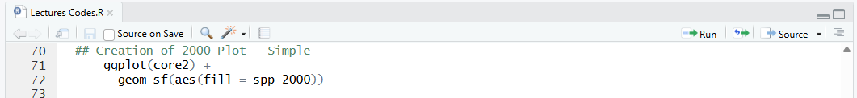
Working with ggplot2
Scripting order
  Start with calling the function [ggplot()]and then assign any constants (like data source).
  Start adding plot layers (geoms) from the bottom up (each line is placed above the last plot) setting their key elements with the aesthetics command [aes()]
  Modify the plot space where the graph is shown
  Call the function and assign data source as core2 dataframe.
  Add our first layer of an ‘sf’ object and define the aesthetics of how to fill the states

Slide 29
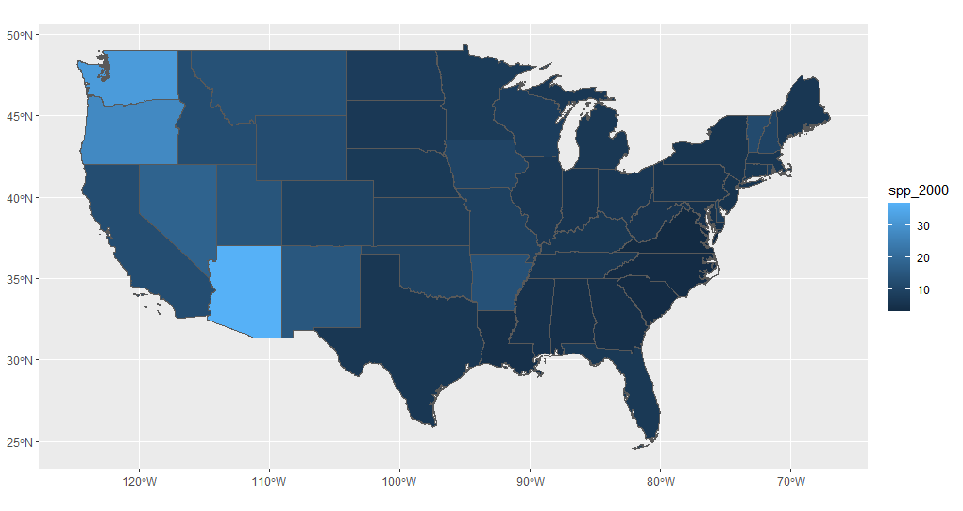
Working with ggplot2

Slide 30
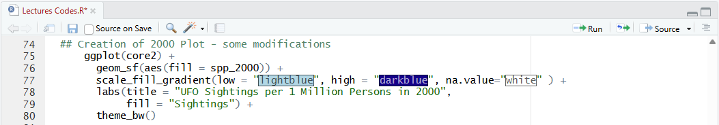
Working with ggplot2
Once we have the key elements on the plot, we can start our customization {google is a GREAT resource for ideas and troubleshooting}
  Call the function and assign data source as core2 dataframe.
  Add our first layer of an ‘sf’ object and define the aesthetics of how to fill the states
  Create new color ends for our gradient fill with light being low end and darker being high end
  Label our graph and our legend.
  Make the background a bit cleaner.

Slide 31
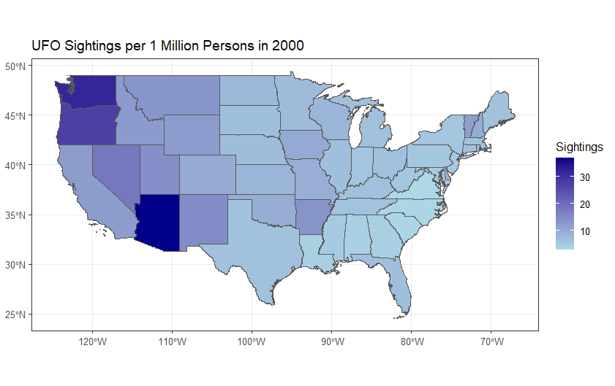
Working with ggplot2

Slide 32
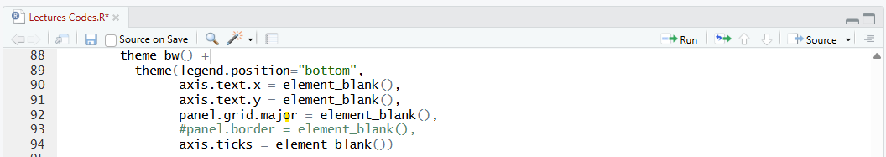
Working with ggplot2
The theme() command is where we can really get to customizing.
  Make the background cleaner
  Move the legend to bottom and make it horizontal
  Remove the x-axis tick labels
  Remove the y-axis tick labels
  Remove grid lines in the plot area
  Remove the box around the graph (this is commented out so R will ignore it and leave the box).
  Remove the axis tick marks

Slide 33
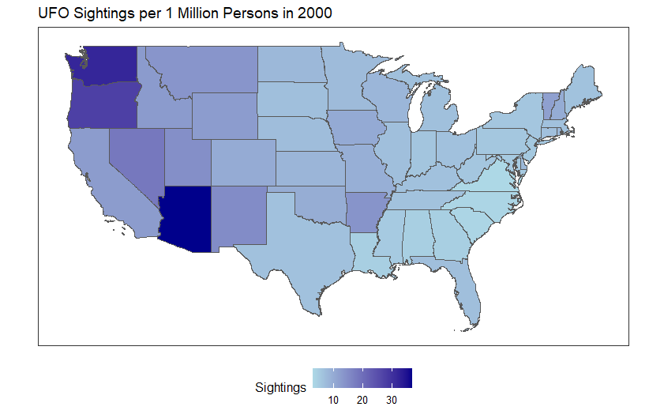
Working with ggplot2

Slide 34
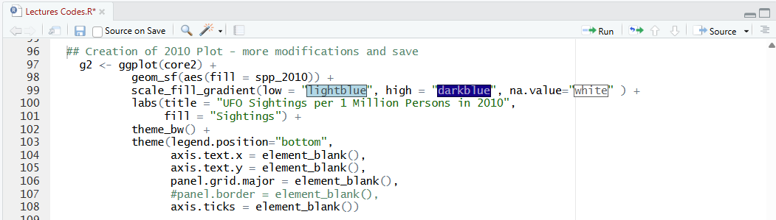
Working with ggplot2
Real quickly, repeat this for the year 2010 and save as g2

Slide 35
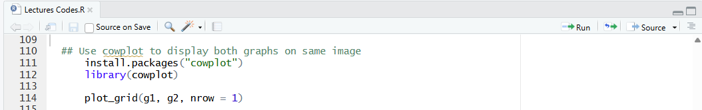
Working with ggplot2
We can also put both our graphs in the same picture using another package (cowplot)
  Install the package we need
  Load it into the environment
  Create a one row grid of plots with the 2000 and 2010 version of the plots we made.
To assign a plot to an object, we just add the assignment operator before the ggplot() command call.
g1 <- ggplot(core2) +

Slide 36
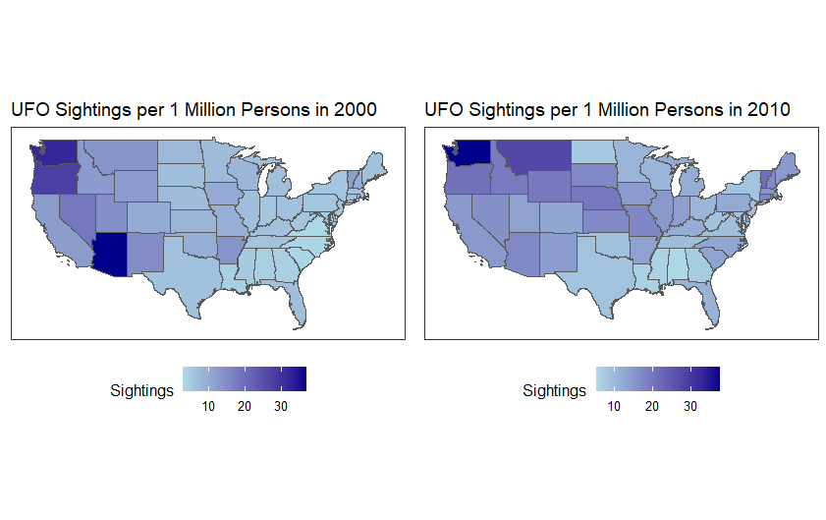
Working with ggplot2

Slide 37
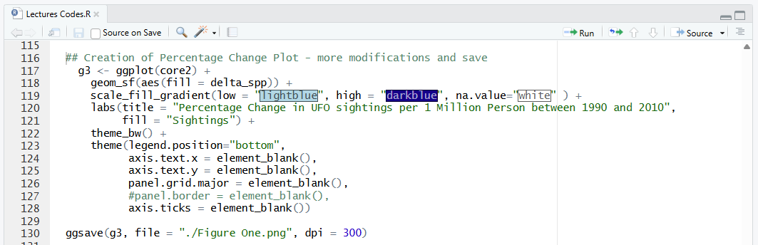
Working with ggplot2
To display our visualization we are working for, we can just copy the previous code and make some adjustments where needed.
We also add the command to save this graph to our computer as a .png file for addition in a presentation document.

Slide 38

Working with ggplot2

Slide 39
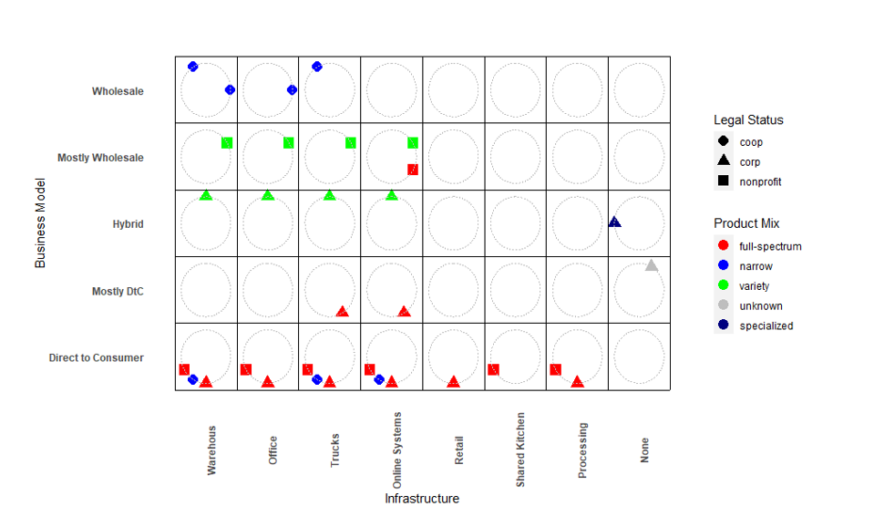
Create your very own graphics
Plot created for a project with 12 different organizations of different types and classifications and wanted to show their business model and available infrastructure in a single image
Based on the hands of a clock with each organization numbered 1 - 12

Slide 40
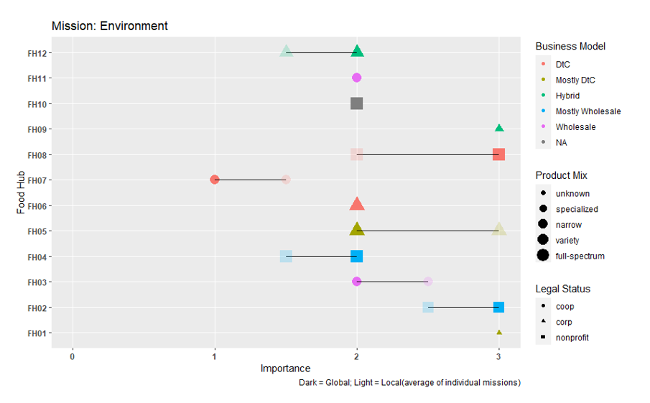
Create your very own graphics
Convey the range of importance of the environment to each of the organizations by type, legal status, and business model
Like a plot of regression coefficients.

